Slide 1

ASCENT & TREP
Senior Presentation
Programs designed and funded by the State of Colorado to help students move into post-secondary education with financial support

Slide 2
Agenda
  What is ASCENT and TREP?
    Financial Aid
    TREP Specific Coursework Requirement
  ASCENT and TREP Partners
  Post-Secondary College Readiness
  How to apply

Slide 3
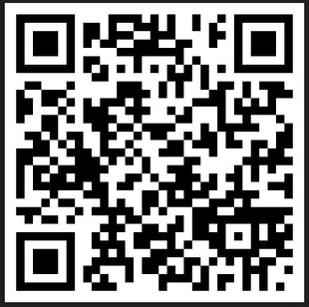

www.cherrycreekschools.org/Page/14839
ASCENT
Accelerating Students through Concurrent ENrollmenT
  One year program: full time (12+ credit hours) part time (11 or less credit hours)
  Minimum of 9 college credits, successfully completed (C or better), transcribed on a college transcript
  Must be college ready (details on slide 5)
  CCSD pays for tuition, books, and fees* associated with the courses
  High School Diplomas are given after the ASCENT year
  All courses taken during the ASCENT year are transcribed on the high school transcript and college transcript
  Must apply for FAFSA or CAFSA - but cannot accept financial aid during ASCENT
  Slot limitations
*Options students: only part time (3-11 hours) is available and tuition is paid (not fees, books)
Notes:
Students socially graduate with their class
Students are considered a 5th year senior

Slide 4

TREP
www.cherrycreekschools.org/Page/14839
Teacher Recruitment Education & Preparation
  Two year program for students who want to be a teacher, high school
counselor, school social worker, school language pathologist, etc.
  Must be college ready (details on slide 5)
  Specific number of slots issued by State of Colorado. Decisions of who will be sponsored with TREP are made in May.
  Full time (12+ credit hours) part time* (11 or less credit hours)
  Students must take one of the required courses DURING their senior year (details on next slide).
  CCSD pays for tuition, books, and fees associated with the courses
  High School Diplomas are given after the TREP program is completed
  All courses taken during the TREP program are transcribed on the high school/college transcript
  Must apply for FAFSA or CAFSA - but cannot accept financial aid during TREP
*Options students: only part time (3-11 hours) is available and tuition is paid (not fees, books)
Notes:
FEP students automatically meet this coursework requirement.
Students socially graduate with their class
Students are considered a 5th year senior and then a 6th year senior during the second year

Slide 5
FINANCIAL AID
In the ASCENT and/or TREP program, you CANNOT accept FAFSA, Pell, or any other federal financial aid. This includes scholarships designed for first-year college students and work study programs!

Slide 6

State requires you to apply for FAFSA or CAFSA to be eligible for ASCENT/TREP
ASCENT/TREP
FAFSA/CASFA
Tuition
Books
Loner Laptop
Required Fees Billed by College/Program (not housing/meals, not private flight lessons, not transportation)
One
or the Other
NOT BOTH!!
Pell Grants
Guaranteed Student Loans
Colorado Student Grants
Institutional Aid such as Merit Scholarships
*Work Study
Other State Aid
*can work an hourly on-campus position

Slide 7
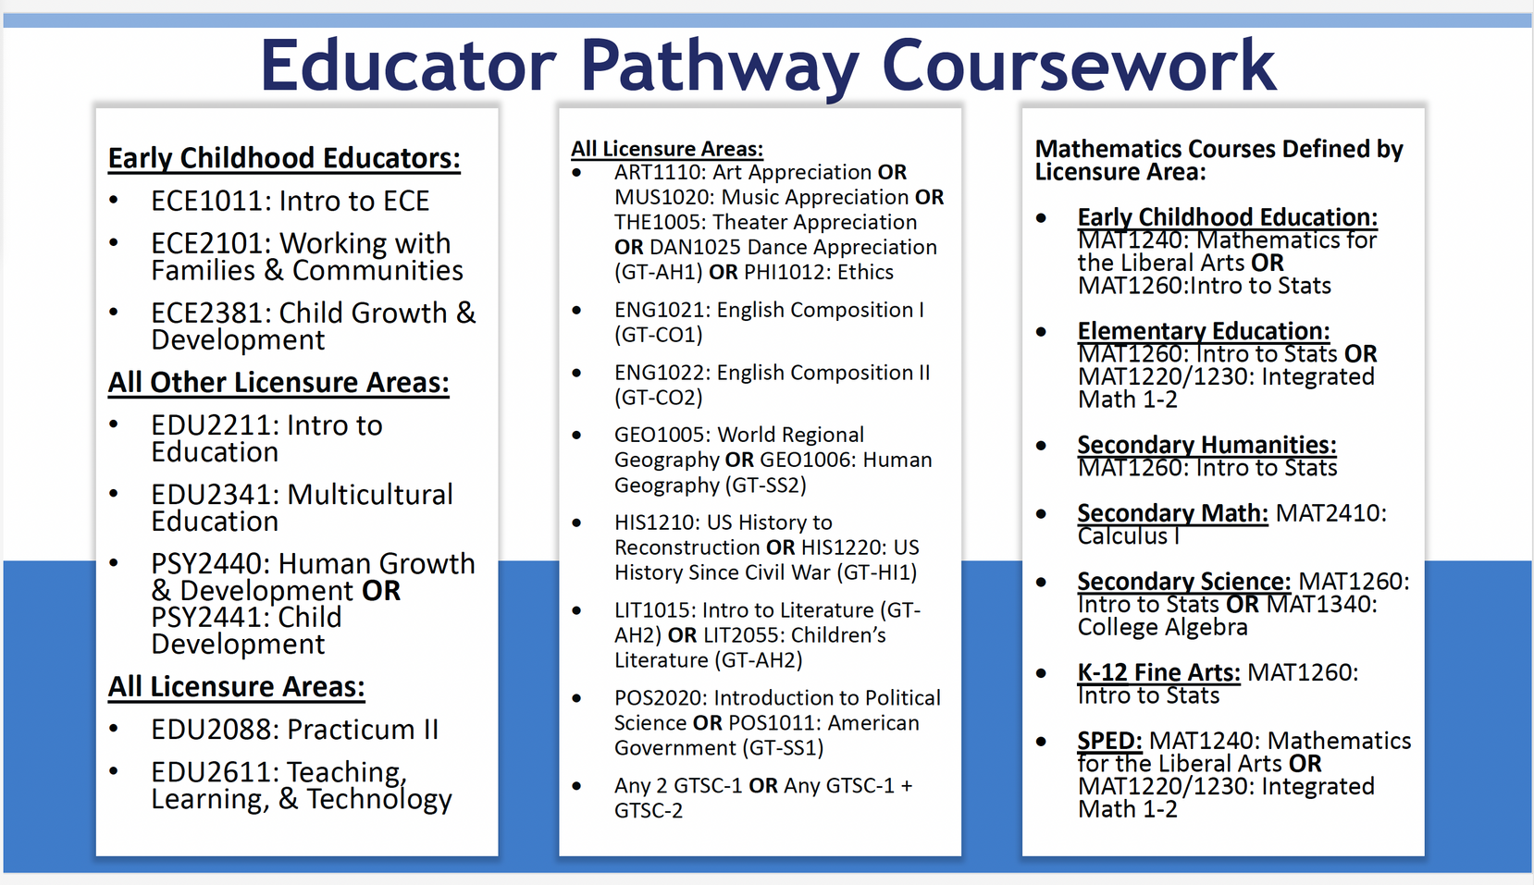
TREP
Students must take one of these required courses DURING their senior year to be eligible for TREP.
These are the course names and numbers specified by the Colorado Department of Education and may be referred to differently at your home high school. Ask your counselor.
Notes:
College credit in this class- not just sitting in the high school section

Slide 8








ASCENT TREP Partners

Slide 9
What is College Readiness?
ENGLISH MATH
Pick one:
  SAT English - 470
  ACT English - 18
  ENG 1021 - English Composition, C or better, registered for college credit
  Accuplacer Next Generation Writing - 246
Pick one:
  SAT Math - 500
  ACT Math - 19
  MATH 1340 - CE College Algebra, C or better, registered for college credit
  Accuplacer Next Generation AAF - 235

Slide 10
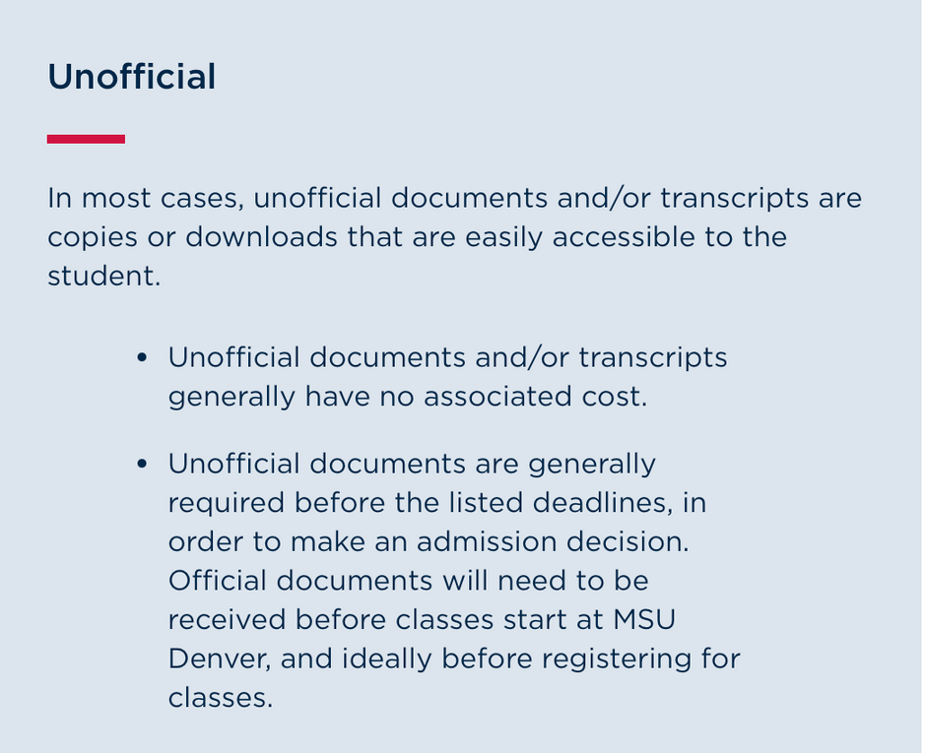
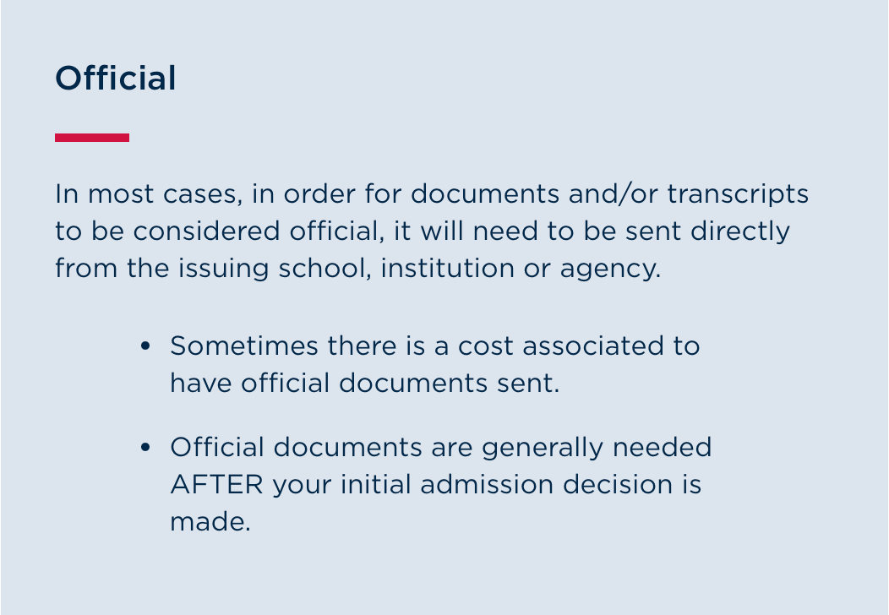
Unofficial vs. official transcripts
CCSD ASCENT needs your unofficial transcripts to show the 9 CE credits.
We do NOT send these to your college.
To receive credit for CE or DE classes, send your official transcripts to the college you are attending.

Slide 11
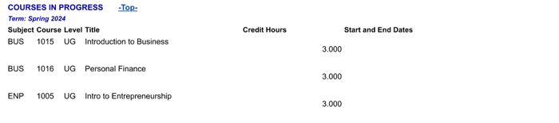
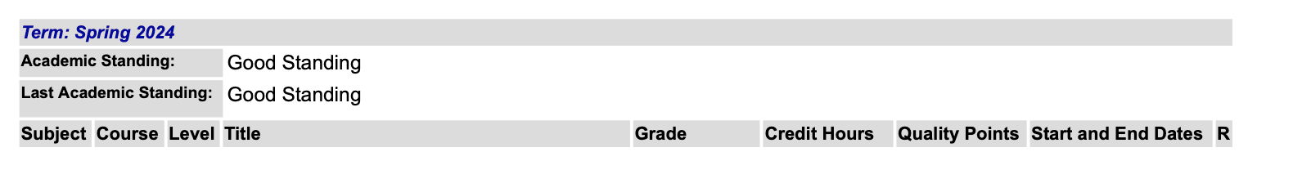
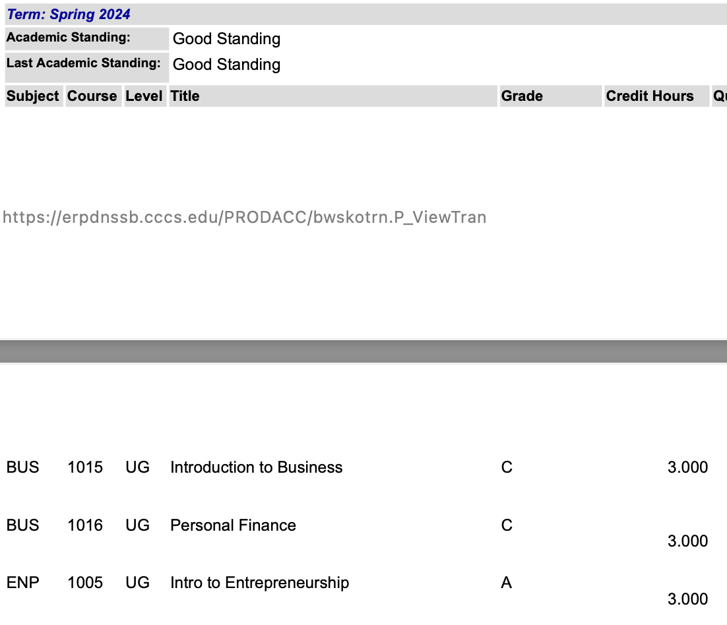

Unoffical Transcript Examples

Slide 12
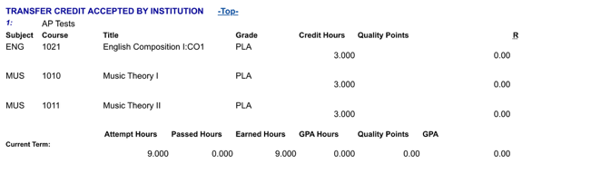
AP Credits

Slide 13

Where do I start?
Meet with your high school counselor
  Ask for your postsecondary student report
  Identify if ASCENT or TREP is a better fit
  Check college readiness and other qualifying measures
Apply for FAFSA (12/1) and/or CAFSA (now!)
  Take a screenshot of your confirmation page
Select a partnering college and understand the application process
Download your unofficial transcripts (pdf)
If you will be using AP test scores from junior year for college credit, go to college board and send AP scores to the college/university you want to attend in order to be transcribed

Slide 14
www.cherrycreekschools.org/Page/14839
How to Apply
  Have your materials ready
    Unofficial transcripts showing 9 credits
    Can show in-progress, but will need to upload at later date
    Screenshot of FAFSA/CAFSA completion
    Student Statement (more info in the application)
  Apply to the college/program you wish to attend .
  Complete the application!
FEB 1- MARCH 31

Slide 15
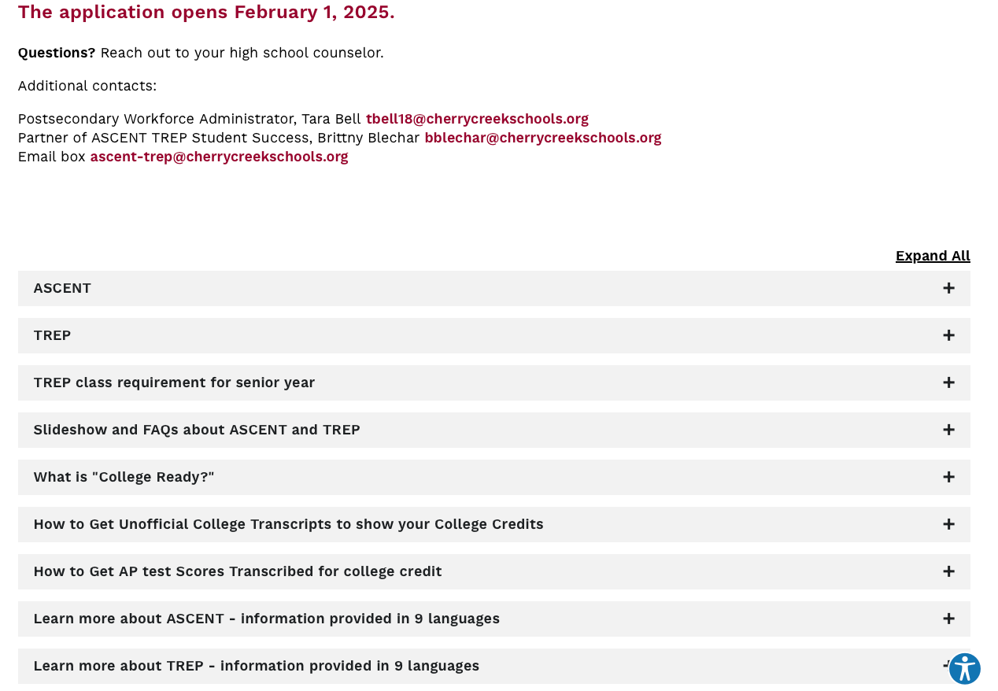
www.cherrycreekschools.org/Page/14839

Slide 16

Frequently Asked Questions
  Why does the district hold my diploma until I finish the ASCENT or TREP programs?
    Both programs are concurrent enrollment. In order for students to participate in these programs, they must remain high school students in order to qualify for concurrent enrollment.
  Can I graduate early and participate in ASCENT or TREP?
    Unfortunately, legislation is clear in that a student can only participate in these programs following their 4th year of high school directly following their 12th grade year. This language also takes out the option of students taking a gap year before going to college.
  Can I participate in ASCENT to earn a certification?
    Absolutely! Attending one of the community colleges or a technical college is a great place to earn a certification.
  What if I fail a class?
    If you fail a class, that class grade will be on your high school and college transcripts. It is essential to work with your college advisor on appropriate courses. The district will not ask you pay for the failed course.

Slide 17

Frequently Asked Questions
  Can ASCENT/TREP students live on campus?
    You will need to check with the institution to see what their requirements are for living on campus.
  Can I use financial aid with the ASCENT/TREP program?
    NO. Because students are retained as a CCSD high school student, you are not able to accept financial aid.
    Students can apply for scholarships that do not require first-time, undergraduate college student status.
  What will it look like when I matriculate to a four-year university?
    That will depend on the university. It is highly suggested that you meet with a college advisor from the university that you’d like to attend after your ASCENT/TREP year(s).
    They can help make the decision which course you should take and determine how the courses will transfer.
  Can I use AP/IB/CLEP test scores to qualify for ASCENT?
    Yes, but the test score needs to be transcribed to count as a part of the 9 credits required for eligibility.

Slide 18
Frequently Asked Questions
  Can I change my mind?
    Yes! You can fill out the application, you and your guardians and can sign the ASCENT/TREP agreement AND you can still change your mind. We know that you will be analyzing a lot of factors to determine what is the best next step for you. Sometimes you receive information in April, May or June that will influence your post secondary choices.
    Please inform our office if you change your mind so we can inform the college and your high school registrar. Your registrar will process your official diploma. TBell18@cherrycreekschools.org or ascent-trep@cherrycreekschools.org

Slide 19
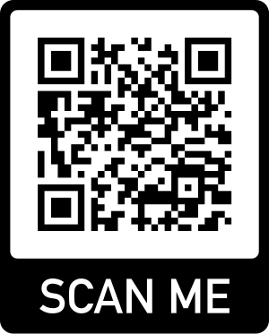
Contacts and Resources
Your high school counselor
PostSecondary Workforce Readiness Department
Brittny Blechar, Partner of ASCENT and TREP, bblechar@cherrycreekschools.org
Tara Bell, Administrator, tbell18@cherrycreekschools.org
Margaret Krob, Department Specialist, mkrob@cherrycreekschools.org
Your high school course guide lists CE classes
District website < Programs < Career and Technical Education
Colorado Department of Education Website
https://www.cde.state.co.us/postsecondary/ascentfaqs
https://www.cde.state.co.us/postsecondary/trepfaqs
www.cherrycreekschools.org/Page/14839

